Slide 1
PIP4004: UNIVERSITY PROJECT Review-1 Presentation ANALYSIS AND IDENTIFICATION OF MALICIOUS MOBILE APPLICATION
Batch Number: CCS-G20
Under the Supervision of,
Dr. MOHANA S D
Assistant Professor
School of Computer Science and Engineering
Presidency University
Roll Number | Student Name
20221LCC0002 20221LCC0003 20211CCS138 | SHASHANK.M KEERTHANA.S MURALI KARTHIK K L
Name of the Program: CSE (CYBER SECURITY)
Name of the HoD: DR. S.P.ANAND RAJ
Name of the Program Project Coordinator: DR. SHARMASTH VALI
Name of the School Project Coordinators: Dr. Sampath A K / Dr. Abdul Khadar A / Mr. Md Ziaur Rahman

Slide 2
Introduction
In today's digital age, cybersecurity threats are more prevalent than ever, and understanding malware is crucial for protecting our online presence. With malicious software becoming increasingly sophisticated, we need effective tools to analyze and detect these threats efficiently.
Malware Detection: Utilizing the Virus Total API to scan files and URLs for known threats.
Domain Reporting: Analyzing domains for registration details and security incidents to enhance user awareness.

Slide 3
Literature Review
S.NO | Title | Authors | Year | Summary
1 | A Survey on Malware Detection Systems | Alazab, M., & Islam, R. | 2019 | Surveys detection systems: signature-based, heuristic, behavior-based; advocates hybrid methods for improved results.
2 | Mobile Malware Detection: Current Trends and Challenges | Zhauniarovich, A., & Pashchenko, A. | 2020 | Discusses mobile-specific malware threats; favors lightweight, behavior-based methods.
3 | Machine Learning Techniques for Malware Detection | Bhalaji, A., & Anjaneyulu, M. G. | 2018 | Explores ML techniques like SVM, DT, NN; notes scalability concerns in mobile use.
4 | Threat Intelligence and Malware Analysis: A Literature Review | Behnia, M., & Abolhasani, M. | 2020 | Highlights VirusTotal and API-based intelligence in malware detection; recommends real-time mobile apps.
5 | Design and Implementation of a Mobile-Based Malware Detection System | Malek, R., & Elhoseny, M. | 2019 | Details Android malware detection app using heuristic and signature methods.

Slide 4
Proposed Method
Hybrid Detection Approach
Utilization of APIs
User-Friendly Interface
Enhanced IP and Domain Analysis
Machine Learning Implementation

Slide 5
Objectives
Develop a Malware Detection System
Integrate VirusTotal API
Implement User-Friendly Interface
Enhance IP and Domain Analysis Features
Incorporate Machine Learning Techniques

Slide 6
Methodology/Modules
Research and Requirements Gathering
Architecture Design
Module Development
4. IP and Domain Analysis Module
5. Machine Learning Module

Slide 7
Architecture
Architecture Pattern
Component Structure
User Interface Layer
Backend Services
Third-Party API Integration
Scanning Module
File Scanning
IP and Domain Scanning

Slide 8
Hardware/software components
Mobile Application
State Management Solutions
Database Management System
External APIs
VirusTotal API
IP/Domain Analysis APIs

Slide 9
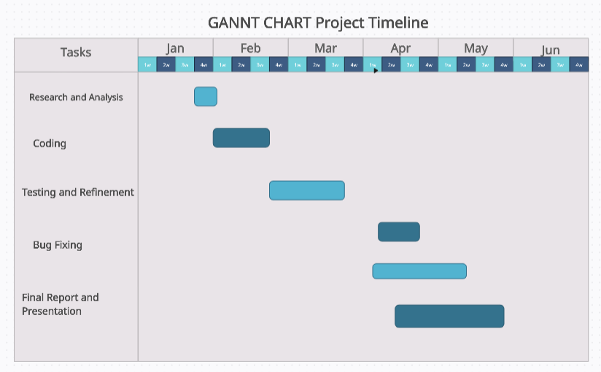
Timeline of Project

Slide 10
Expected Outcomes
Functional Malware Analysis Application
User-Friendly Interface
Accurate Malware Detection
Real-Time API Integration

Slide 11
Conclusion
The development of a mobile app tool that leverages open-source intelligence and threat intelligence feeds is a crucial step toward addressing these emerging security concerns. This tool can actively monitor mobile device behaviors, network communications, and interactions with external IP addresses and URLs to identify potential threats. mobile device security, offering both individual users and organizations an additional layer of protection against the growing number of threats targeting mobile platforms. As the landscape of cybersecurity continues to evolve, tools like these will be pivotal in safeguarding user data and maintaining the integrity of mobile systems.

Slide 12
Github Link
The Github link provided should have public access permission.
Github Link

Slide 13
References
M. Alazab and R. Islam, “A Survey on Malware Detection Systems,” Journal of Cybersecurity Research.
A. Zhauniarovich and A. Pashchenko, “Mobile Malware Detection: Current Trends and Challenges,” International Journal
of Information Security.
A. Bhalaji and M. G. Anjaneyulu, “Machine Learning Techniques for Malware Detection,” IEEE Transactions on Information
Forensics and Security.
M. Behnia and M. Abolhasani, “Threat Intelligence and Malware Analysis: A Literature Review,” ACM Computing Surveys.
R. Malek and M. Elhoseny, “Design and Implementation of a Mobile-Based Malware Detection System,” Journal of Computer
Security.

Slide 14

Project work mapping with SDG

Slide 15
Thank You

